Slide 1
SteelBrick Introduction Slides
March 2016

Slide 2










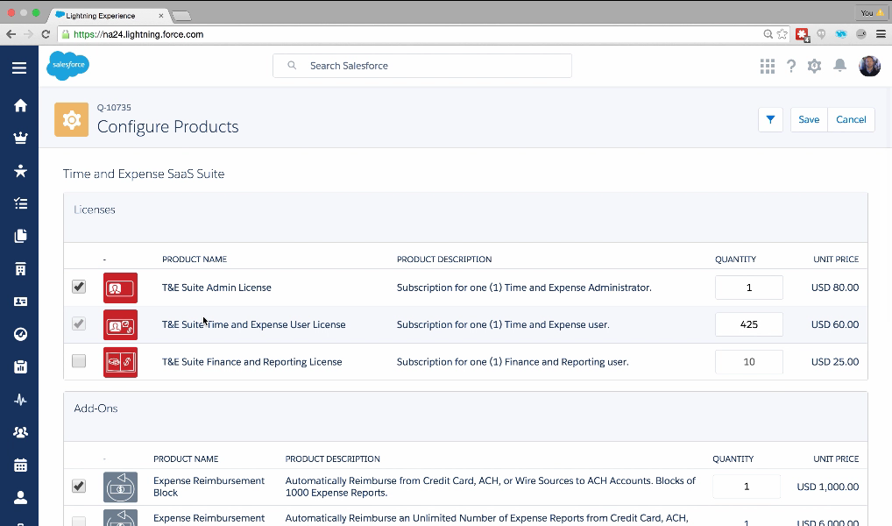
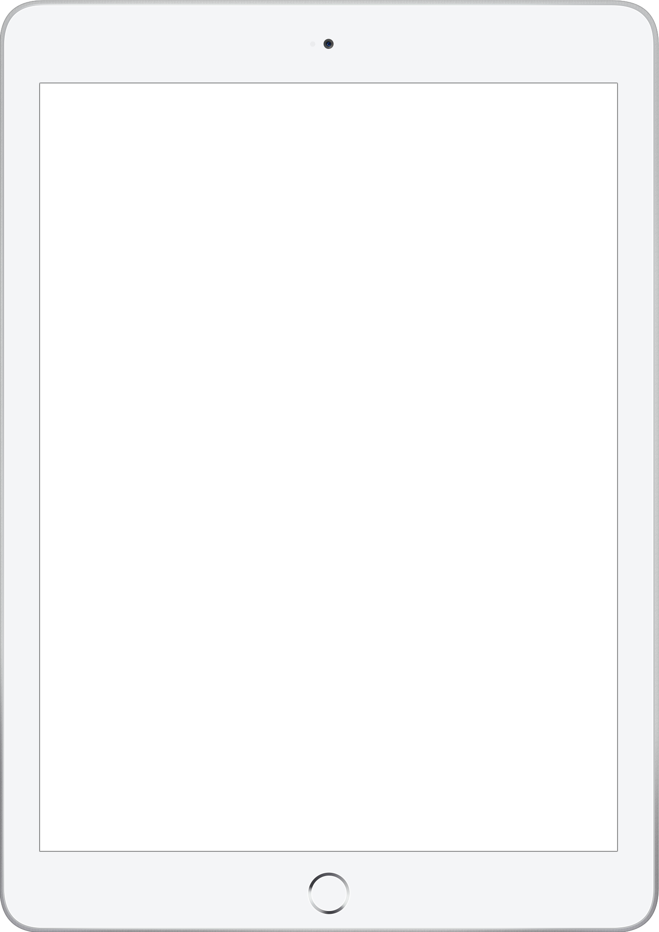

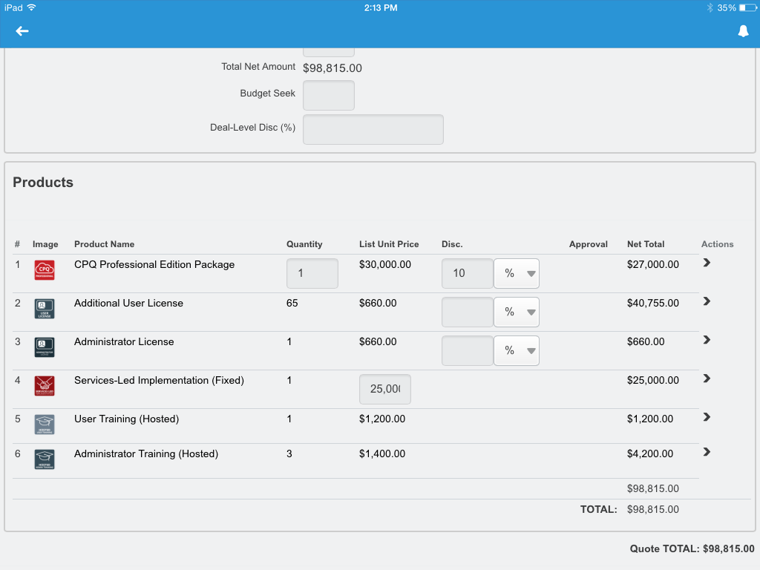
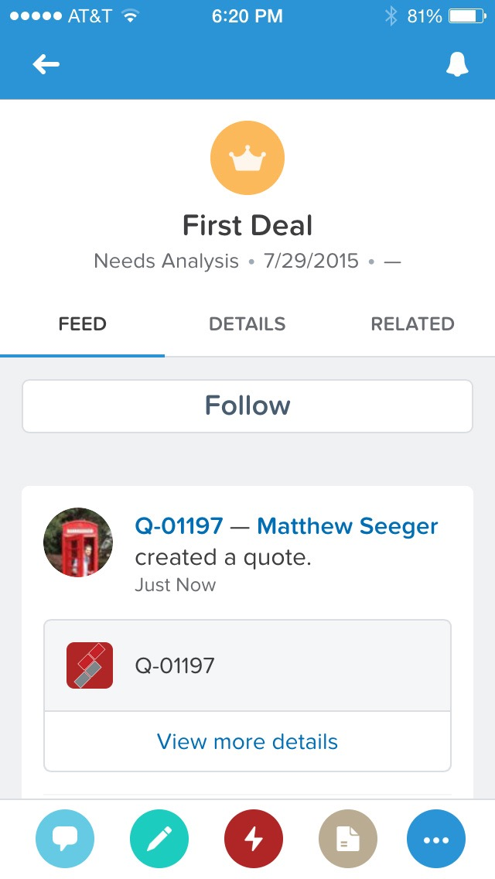
Sales Cloud Lightning
Introducing
NEW
Salesforce SteelBrick CPQ
Complete lead-to-cash
Built on Lightning
Connected to Sales Cloud data
Configure Price Quote
Configure products & pricing, deliver quotes quickly
Propose & Contract
Quickly generate proposals, contracts & renewals
Notes:
So what is exactly is SteelBrick? It is a CPQ tool that lets your customer configure products and pricing and deliver quotes, contract and proposals all through the sales cloud. It is native to the platform, and it is Lightning enbabled, and S1 mobile enabled so sales reps can send quotes from the field.

Slide 3









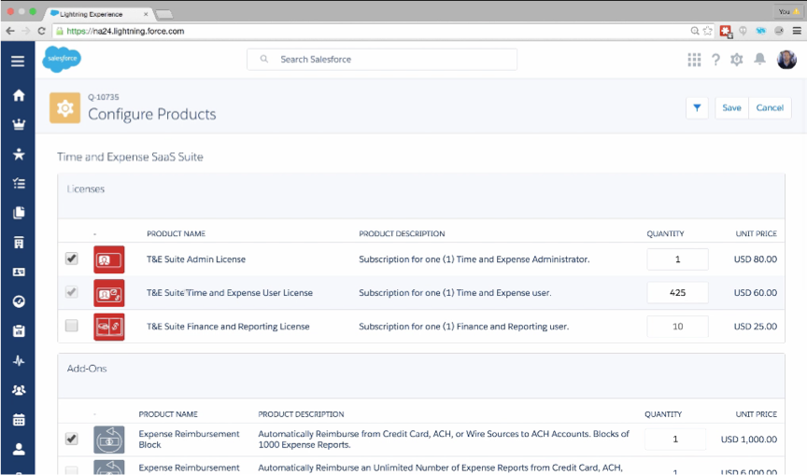

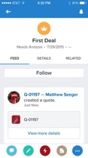

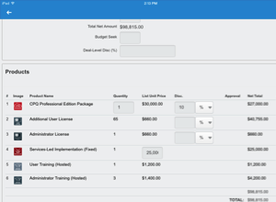






Salesforce SteelBrick CPQ
Quote-to-Cash with Lightning Experience
Accurate sales quotes
Create customer-friendly sales quotes easily
Faster Branded Proposals
Build custom templates to match your business
Automated quote-to-cash process
Streamline the journey from lead to revenue
⁺80%
faster quotes
 | Relationship Intelligence | Mobile | Productivity | Intuitive | Salesforce Automation | Contextual Data
Notes:
Alt sub-text - Next generation Quote-to-Cash

Slide 4
Introducing SteelBrick CPQ
Built Native on Salesforce Platform
Configure
Price
Quote
Select & Configure
Price & Discount
Propose & Contract
Notes:
So what is SteelBrick???? SteelBrick is a CPQ app built 100% native on the Salesforce platform. CPQ Stands for Configure, Price, Quote. Our biggest competitors are excel and apttus.
And you are all familiar with what it is like to be a user of Apttus.

Slide 5
Next Generation Quote-to-Cash
Native on Salesforce Platform
Select & Configure
Price & Quote
Propose & Contract
Order & Renew
Bill & Collect
Analyze & Forecast

Slide 6
SteelBrick Customer Success Slides
March 2016

Slide 7
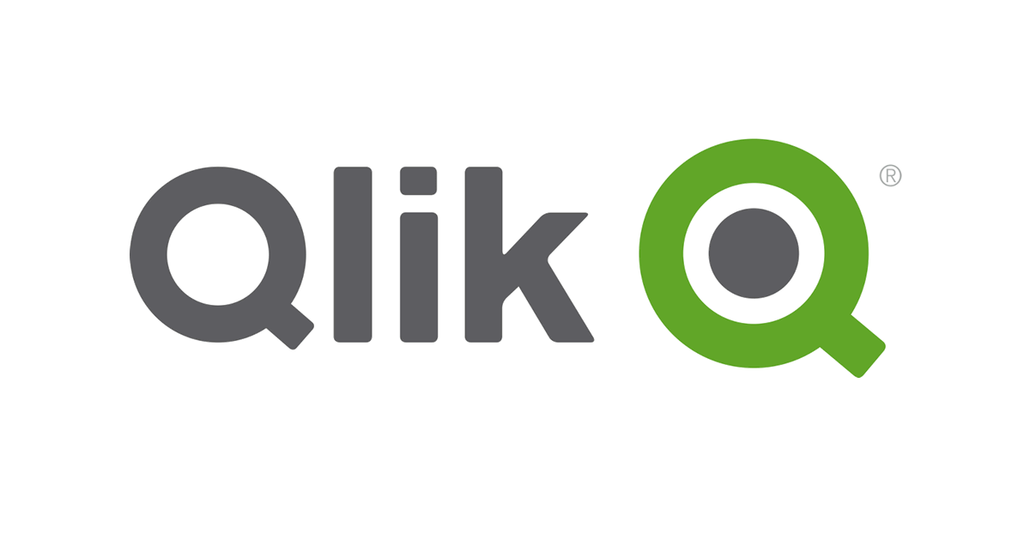
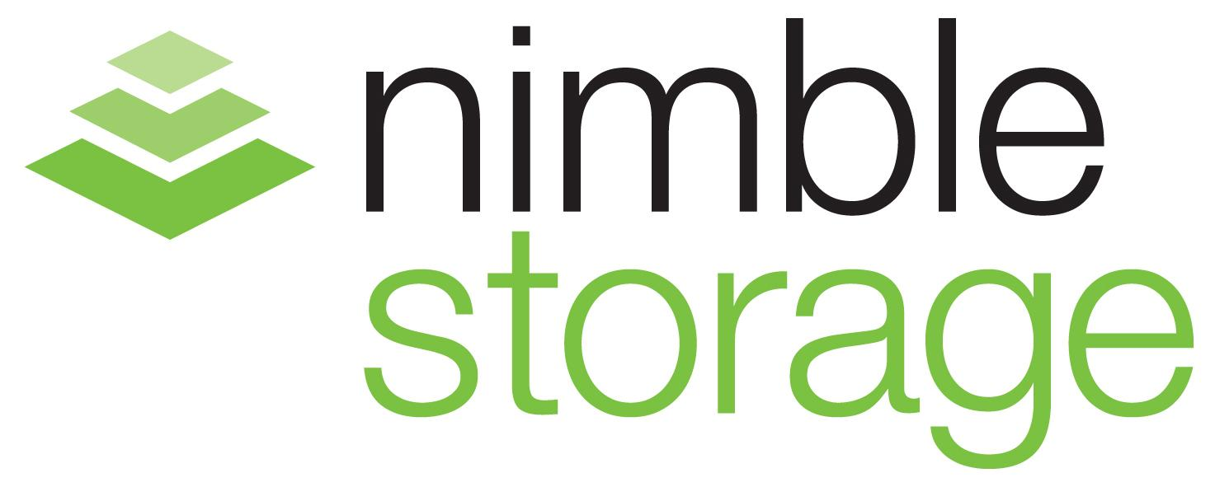










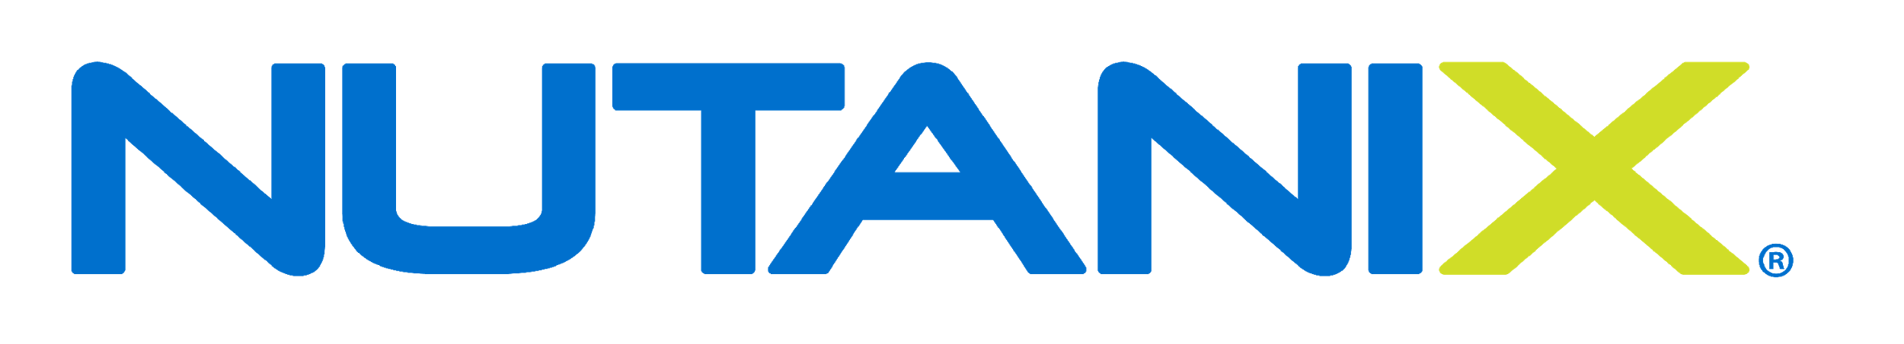















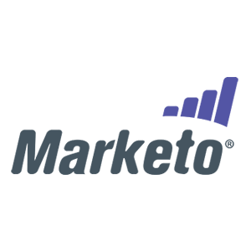


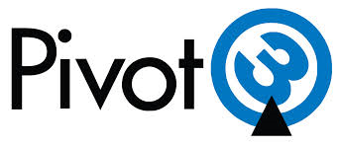


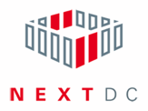









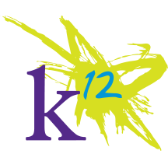



















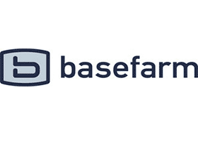











Customers by Vertical
Software
Hi-Tech
Life Sciences
Manufacturing
Services
Telco & Hosting
Media
Education

Slide 8






What Our Customers Love
Lars Nilsson
VP, Global Inside Sales
Ruchika Chopra
Manager Sales Operations
Chris Osment
Director of Applications
“We went live in 2 weeks and achieved rapid adoption. We increased order value and renewal rates by bundling value-added services and improved margins by controlling discounts.”
“It’s a lot simpler, easier, faster, more accurate. One in five quotes had a problem earlier… We don’t have errors now.”
“With SteelBrick we were able to roll out three times faster at 50% the cost. We delivered a seamless quoting experience on time to our sales reps and dealer channel.”

Slide 9








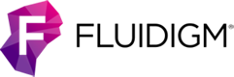
Health and Lifescience Customers Love SteelBrick
“SteelBrick is easy to use, quick to deploy, highly customizable, and fully integrated into Salesforce”
Jason Baker VP Global Sales Operations

Slide 10











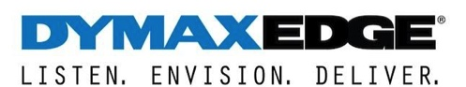



Manufacturing Customers Love SteelBrick
“With SteelBrick we were able to roll out three times faster at 50% the cost. We delivered a seamless quoting experience on time to our sales reps and dealer channel.”
Chris Osment, Director of Applications

Slide 11


Dexter + Chaney Rebuilds the Partner Experience on Communities
Construction software company
Difficult buying process led to lost business
Partners had to manually call for quotes
Human error on manual quotes slowed deal cycle
Partner Communities allows for self service quoting
SteelBrick CPQ for quoting tool
Gain visibility into channel pipeline and products sold
Partners can buy more efficiently and collaborate
Notes:
Updated: 1-12-15
Segment: GB
Industry: Hi Tech
About the Company
Seattle based, cloud based construction software commpany
30 years old, ~1000 employees
Sell through partners
Challenges
Before communities, partners had to call into Service/Sales Call centers to obtain quotes
Dexter and Chaney Sales reps had to manually look up pricing
There was a ton of human error and wasted time
Resellers also sold products from other companies, so because the buying process was not simple Dexter + Chaney lost mindshare
How they are using Communities
Self service portal where resellers can access accurate pricing
Results
Much better experience for resellers
Resellers able to buy more efficiently and buy MORE
Increase intelligency-D+C can see what products have sold, what partners look at but have not sold, which partners have best close rates tc.
Cara’s Notes:
PRM Webinar - Curt Westberg - Dexter + Chaney
Webinar Details:
When: Wednesday, February 18th @ 11am PST
Webinar Registration Link: http://www.salesforce.com/events/webinars/?commid=143037
Webinar Showflow (40 mins):
Solution Overview: 15 mins (Cara)
Customer Q&A: 10 mins (Curt & Cara)
Demo: 10 mins (Julian)
Customer Q&A Script:
1) Curt, can you tell us about Dexter + Chaney and your role there?
Seattle based, cloud based construction software company
30 years old, ~1000 employees
1,000 customers in the space
$5 million - $3 million a year in revenue
Sell through partners
2) What kind of challenges was Dexter + Chaney facing prior to deploying Salesforce?
Before communities, partners had to call into Service/Sales Call centers to obtain quotes
Dexter + Chaney Sales reps had to manually look up pricing. There was a ton of human error and wasted time
Resellers also sold products from other companies, so because the buying process was not simple, which caused Dexter + Chaney to lose mindshare.
3) Dexter + Chaney has been a long time Salesforce customer. Where did your journey begin?
Started using Salesforce 8 years ago, one of the early companies.
4) When and why did you bring your partners into Salesforce?
Began to build out a channel sales model (now at 6 channel partners).
Started using Partner portal, because they needed their referral partners to have a place to register leads.
Transitioned to Communities once launched
Using Steel Brick: CPQ to have control over quoting process: partners needed to use steel brick, so we had control over the quoting process. Manage all through partner portal. Much clearer aspect of business process.
5) What kind of benefits are you seeing from using Salesforce?
Have visibility into channel pipeline - including large partner opportunities
Track conversion rates to provide leads to opportunities. How many leads are turning into opportunities.
Resellers able to buy more efficiently and buy MORE
Increase intelligence around products sold. We can now see what products we have sold, what partners look at but have not sold, which partners have best close rates tc.
6) You have been a customer of ours for some time now. And you have seen our product evolve to the Partner Communities solution we have today. What additional benefits have you seen since your Communities deployment?
Now has ongoing relationships with partners
Much better experience for resellers
7) What are your next steps with Salesforce?
New phase of the company - sales & marketing is on salesforce
Would love to transfer more teams to the platform to get a 360 degree view of the customer - holistic (i.e. service & support)

Slide 12
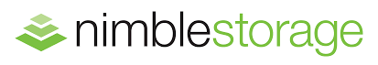
Industry Use Case: High Tech
Data storage provider who sells through direct and reseller channel
Challenge
Direct rep spending time too much time creating quotes for the resellers instead of actually selling.
Direct reps and resellers were sending conflicting or duplicate quotes out to prospects creating confusion and slowing down sales cycle.
Requiring the direct rep to be involved in every single deal in increased quote turn around time.
Result
10% decrease in sales ops support cases
1000+ man hours saved per quarter
2x improvement in quote turn around time
6% increase in quote volume
22% reduction in quote approval time
Nimble Storage
Segment
150 direct sales, 750 resellers
Sales Model
Direct & Resellers
Sales Cloud
Community Cloud

Slide 13

Industry Use Case: Manufacturing
Manufacturer who sells through direct and through the channel
Challenge
Information for quotes was gathered through various avenues, including hand-drawn faxes, emailed PDFs, and 240 versions of Excel spreadsheets
Inventory gaps arose and revenues were unpredictable
Lengthy sales cycle times, decreased productivity among sales reps
Loss of business opportunities that demanded immediate return of quotes
Result
Decreased sales cycle time by 1000% quote approval time reduced from 2 days to 2 hours
Increased documentation of proposals by 30%
Improved sales pipeline visibility, closed inventory gaps, made revenues more predictable
Cut quote pricing verification time by 12 hours / week
Part of a global enterprise with Mitsubishi Electric’s Cooling & Heating Division is focused on climate control systems
Segment: GB
HQ: Lawrenceville, GA
Sales Model
Direct & Resellers
Sales Cloud
Community Cloud

Slide 14






Third Party Validation
appexchange.salesforce.com
www.g2crowd.com
www.glassdoor.com
Ratings and brief reviews from Salesforce users
Look at the quality and depth of reviews, and how recently reviews have been posted.
In-depth reviews from LinkedIn validated users
Filter reviews based on your industry, size and LinkedIn network. Contact customers directly!
Insights from employees on what it’s like to work there
See what employees are saying about their company’s products, people, and culture.

Slide 15
SteelBrick Product Feature Slides
March 2016

Slide 16

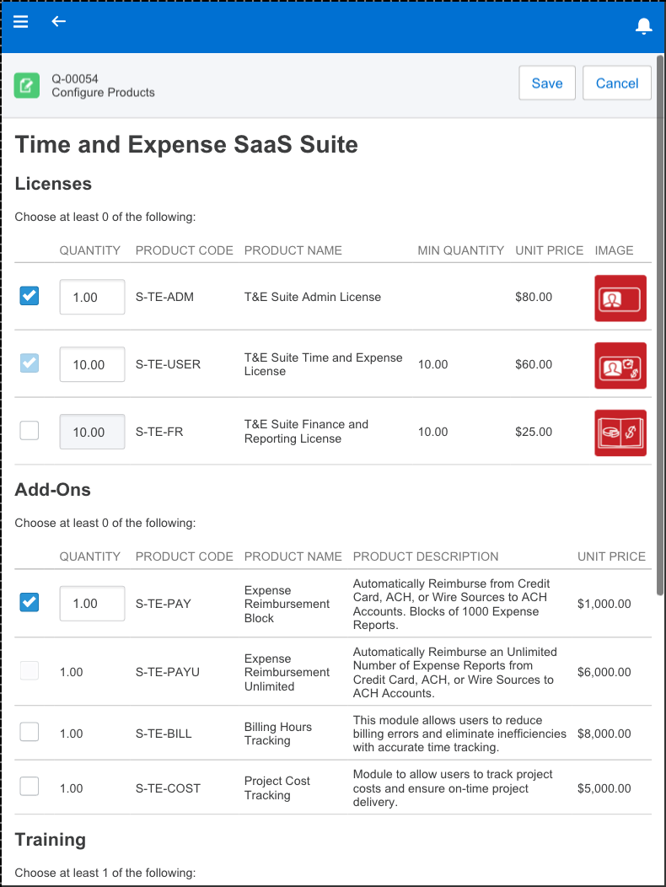
Configuration, Product Bundles & Guided Selling
Product Bundling & Configuration
Product Dependencies & Exclusions
Guided Selling
Allow or restrict product selection during quote creation
Ensure all dependent products are added to quote
Product suggestions to identify upsell and cross sell opportunities
Notes:
Rob just did an amazing demo, and I want to go over a few features for you to remember when you are talking to your customers about their quoting process and SteelBrick.
Configuration and Product Bundles refer to products that need to be included together on a quote or order. for example if you sell a computer monitor, you need to also sell the power cord to plug that monitor in – otherwise that monitor is useless. When creating quotes in SteelBrick, there are logic and rules that make sure sales reps are adding all the required products to a quote.

Slide 17
Price & Quote
Quickly Generate Quotes & Proposals
Discount Controls
Approval Workflow
Discount Parameters & Purchase Rules
Increase rep productivity & speed up sales cycle
Increase margins & price consistency
Reduce approval time & shorten sales cycle
Volume discounts, % of total discounts, contracted price
Notes:
Discount controls & approvals: SteelBrick gives you the ability to create discount controls and build approval workflows all within Salesforce
You wouldn’t believe the amount of companies who quote in excel and spend days chasing down approvals from finance – losing deals to their competition because they can’t get a quote out the door.
Or reps who send out pricing without getting it approved by management, costing their companies hundreds of thousands of dollars each year.

Slide 18
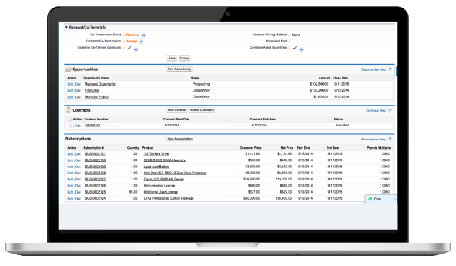
Add-Ons & Renewals
Create Coterminous Add-on Quotes
Product & Contract Summary
Automated Renewal Quotes
Eliminate time wasted & errors spent on calculating add-on pricing
Updated real time based on closed original quote & add-on quotes
Increase renewal revenue with accurate & complete renewals
Notes:
Add-ons and renewals
When you sell a SaaS solution, like everyone in this room - adding licenses to a contract mid-term is very common. Think about how painful it would be to calculate the co-term price if you had to do it manually in excel. This is happening all the time with your customers.
Features like add-ons and automated renewals are huge value props for SteelBrick. Bring them up when talking to your customers.

Slide 19
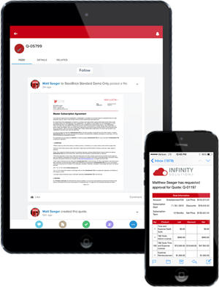
Proposals & Contracts
Contract & Proposal Templates
Approval Workflow
Dynamic Contract Terms & Conditions
Generate branded contracts and proposals for signature
Streamline approval of non-standard contract terms
Conditionally include contract terms based on quote attributes
Notes:
Prosposals and Contracts – this is an out of the box features for steelbrick. You don’t need to purchase another app to generate professional branded contracts and proposals for your customers.

Slide 20
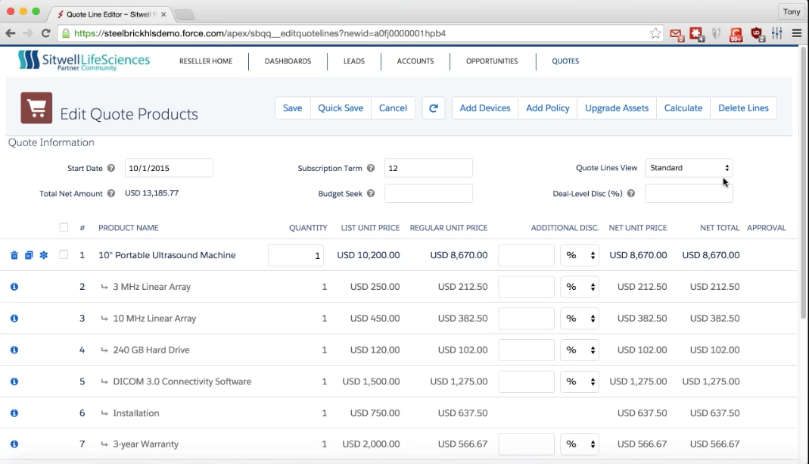
CPQ for Partner Communities
Self Service CPQ for Channel Partners
Partner Specific Pricing & Products
Reports & Dashboards
Improve partner experience, accelerate sales cycle & increase conversion rate
Flexibility to provide partners with custom products and pricebooks
Visibility into your channel business
Notes:
And finally, CPQ for Partner Communities. SteelBrick is not just for internal sales users – if your customers sell through resellers, you should be talking to them about SteelBrick.
It is extremely common for distributors and channel resellers to not be able to create their own quotes, meaning they need to go to their channel manager to generate quotes for them. This is a huge waste of time and is a poor partner experience.
As your customers how their resellers generate quotes.

